Slide 1
3D Modeling in NX
Design Team 11:
He Chen, Annalin Davis, Joshua Folks, Matthew Luzenski, Michael Saybolt

Slide 2
Outline
Modeling Intro
NX Intro
Modeling Basics
Part Methods
Advanced Methods
Constraints
3D Manipulation
Assembly
Notes:
Matt

Slide 3
Why is 3D modeling relevant
Better quality than hand drawings
  Virtual prototype
Easier to adjust
Cannot operate printer without a 3D model
A 3D printer needs precise dimensions input through a mesh file
Notes:
Michael
As many of you are aware, 3D modeling is required for designs, even for electronics. Housings and other fixtures are a necessity for any product, and a well fitting, water-tight housing is essential to ensure a long product life.
While engineering has been done with hand drawing on paper for ages, 3D modeling on a computer can yield more precise results. In addition, changes can be made quickly and accurately by merely changing a variable that is constrained to part of the object.
Having an accurate 3D model of a housing or product allows the designers to see issues before they arise. An accurate 3D model will show any fitting issues and allow them to be corrected before the product is sent into production.
A 3D model serves as a virtual prototype for other design aspects or considerations such as thermal properties. One could do an analysis of the airflow inside an electronics housing and then use the appropriate heatsinks instead of needing a complete prototype to fail before realizing a design change is necessary.
CAD software can often be used to compute volume of a shape or area of a surface. What was once a tedious task in your calculus classes can be done easily on a computer. NX can save you from unnecessary triple integrals!
Most importantly, you cannot operate the 3D printer without first generating Gcode from a 3D model. After finalizing your design, the 3D model is converted into a mesh file that uses a finite number of polygons and points to represent the shape to some set degree of accuracy. This mesh can then be converted into Gcode using CAM software. The Gcode contains the actual commands for the 3D printer to move and operate.

Slide 4
What is NX?
-Complete Product Lifecycle Management (PLM) program
-CAD (Computer Aided Design), CAE (Computer Aided Engineering), CAM (Computer Aided Manufacturing)
-Produced by Siemens
Notes:
Matt
Software by Siemens
Complete PLM program (CAD CAE CAM) focusing on CAD here.

Slide 5
Why NX?
-Integrated CAM and CAE
-Industry Standard
-Used with Teamcenter
Notes:
Matt
Explain what is NX?
Software by Siemens
Complete PLM program (CAD CAE CAM) focusing on CAD here.
Powerful and complete. used with teamcenter
Industry standard for those that can afford it

Slide 6
Modeling
-Concept
-Break down into simple geometries
-Break simple geometries into 2D figures
Notes:
Annalin
How do we model in NX? First you have to have your concept, your idea of what your part is going to look like, what size it needs to be, what shape it is, etc. If you’re making an enclosure, you’ll need to measure what’s going in the enclosure and make sure that your design will fit around that object. Once you have a sufficiently defined concept, you can start breaking it down into simple geometries. You take your concept and break it down into the simple shapes that it’s made up of. A rectangular box, a cylinder, etc. Those shapes can be further broken down into 2D figures which you can model easily in NX. A rectangular box is made up of rectangles, A cylinder is a circle with a height.

Slide 7
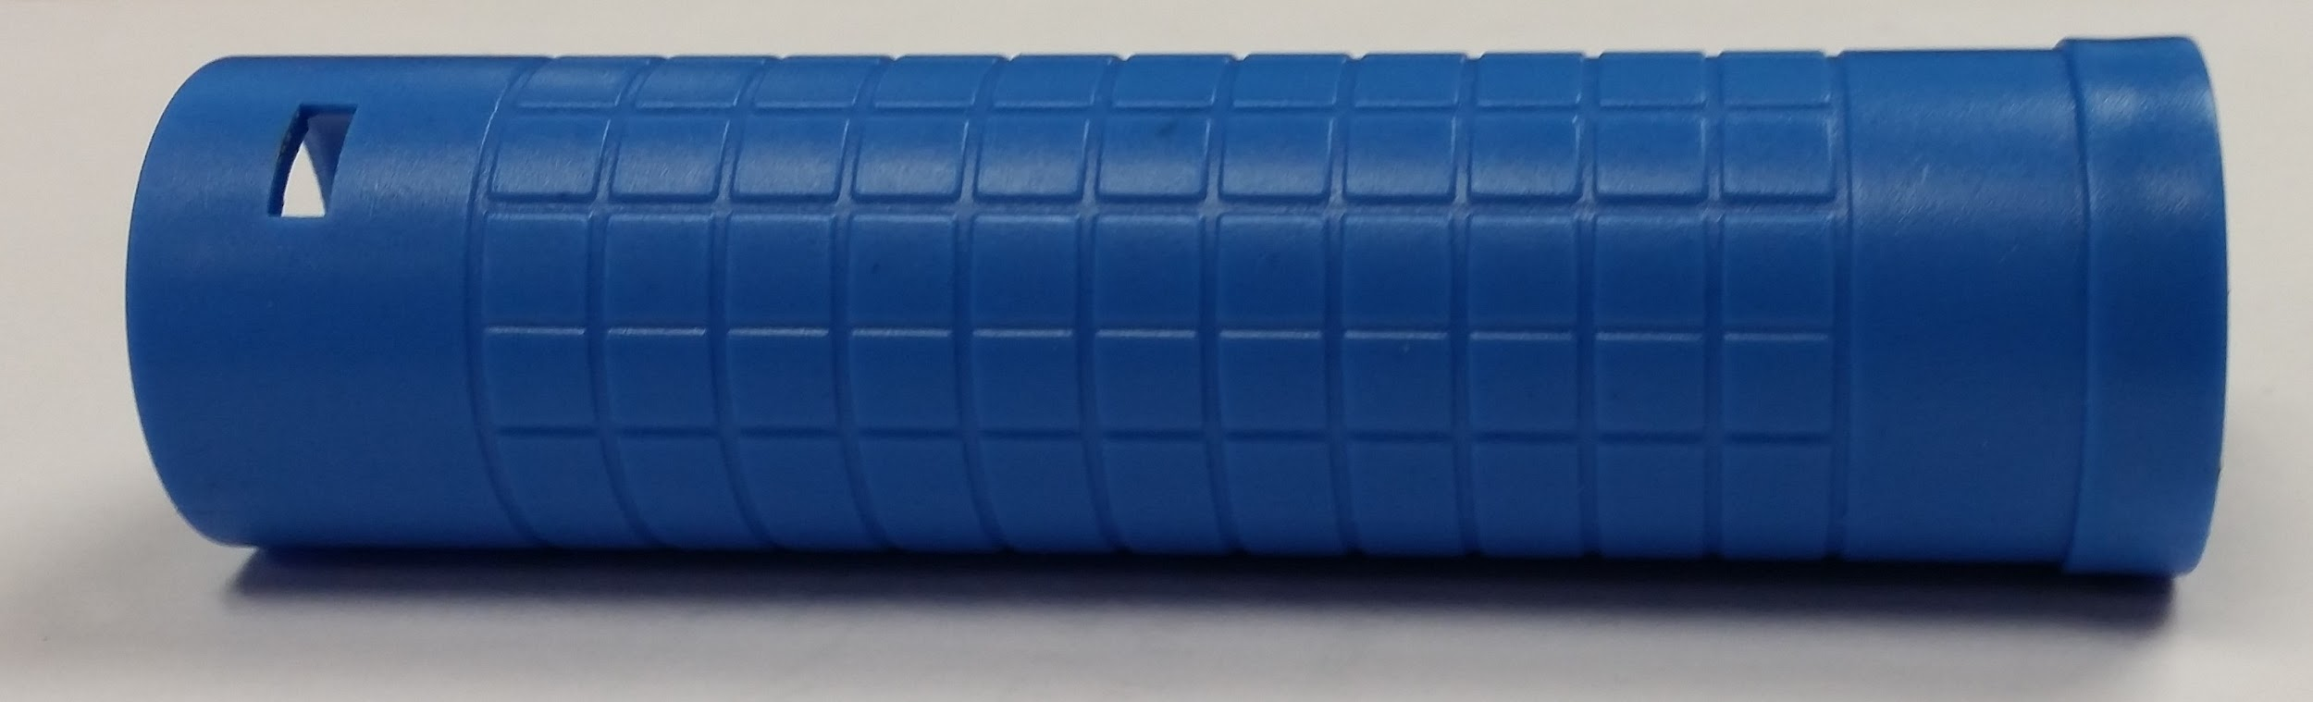
Part Breakdown
Desired part
Notes:
Annalin
So, let’s say that this is our desired part. We want to model this tube. So, we want to know how long the tube is, how thick the plastic is, how large this lip at the edge is, we want to know all of the dimensions related to this part. We can break this part down in a couple different ways, two of which we will demonstrate for you.

Slide 8
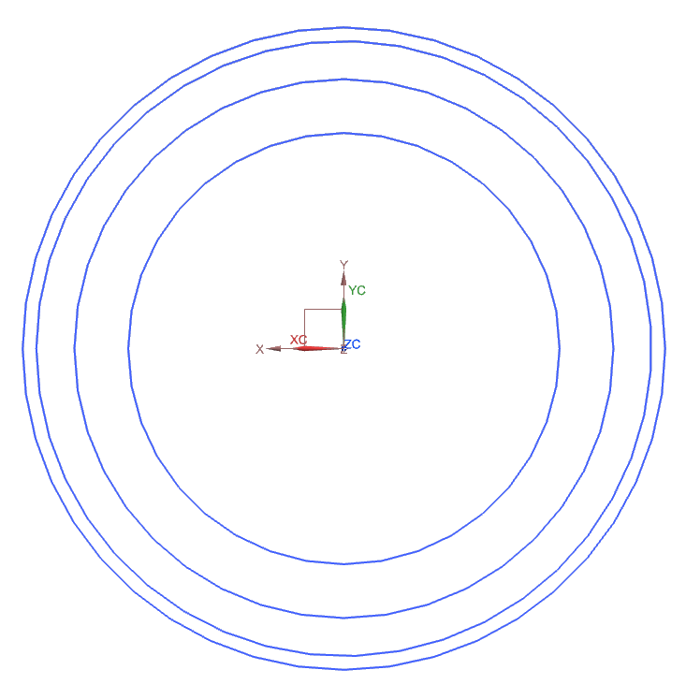
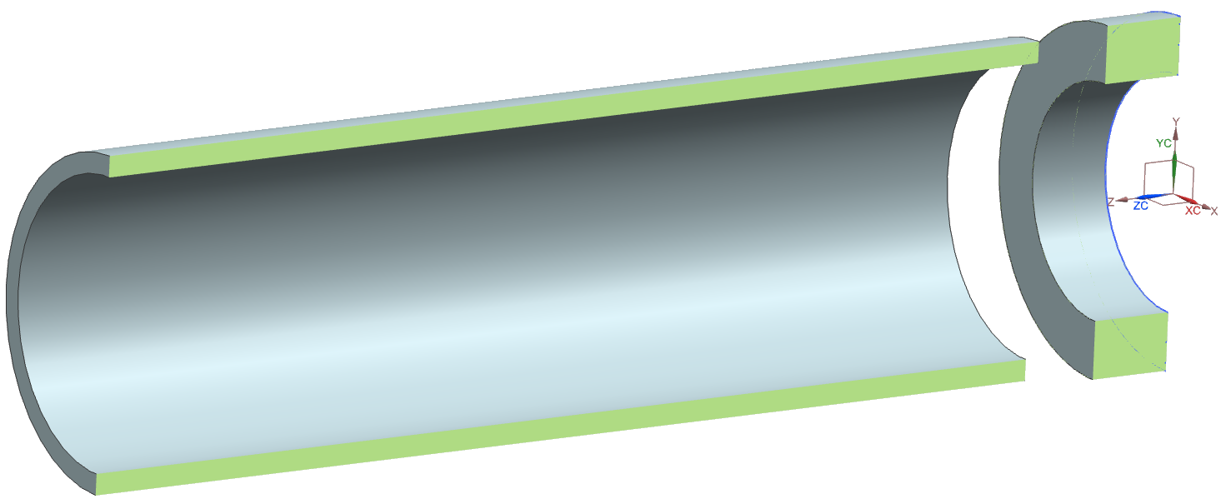
Part Breakdown
Extrusion Method
Notes:
Annalin
The first method we’ll look at is the extrusion method. One of the tools in NX is called “extrude” and this tool allows you to select a shape and pull it upwards. In this example, these circles are lying on the XY plane and we use the extrude function to expand them in the Z direction. The two inner circles are extruded together to make the main part of the tube and the outer circles create the top thicker part of the tube. This picture is a sliced version of the produced tube, to make it easier to see the thickness differences. You might also notice that the two shapes aren’t connected. Connecting the shapes happens after you model the basic parts and will be discussed later.

Slide 9
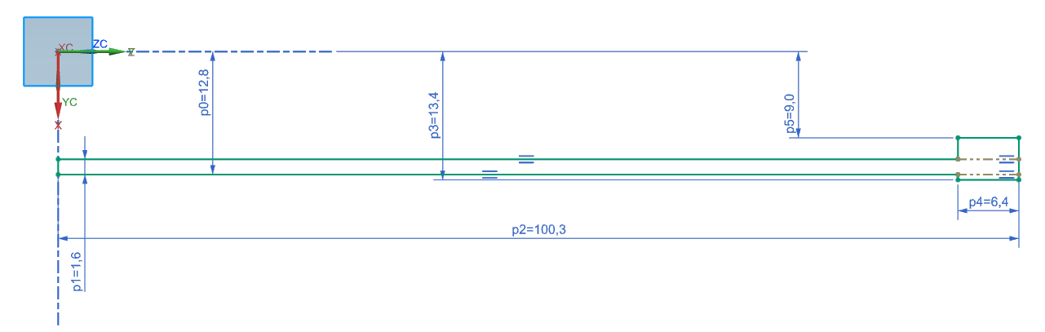
Part Breakdown
Rotation Method
Notes:
Josh
Here is an examples of a method used to create a cylinder type shape in NX.
The rotation method is very simple and can be used in multiple situations.
Start by choosing an axis that you want to rotate the figure across.
Basically the distance the shape is from your figure is the radius of the 3D shape.
Here you see a rectangle that 1.6 millimeters wide and 100 millimeters long so the thickness of the shape will be 1.6 millimeters radius 11.2
Once the rectangle is rotated it is then finalized into a cylinder.

Slide 10
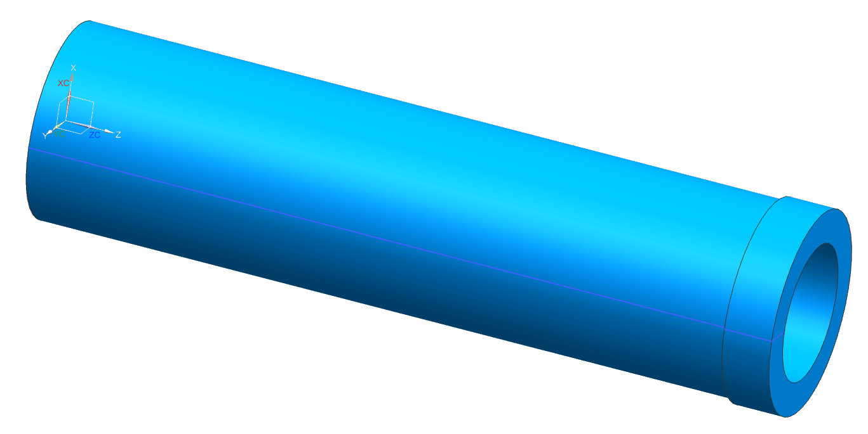
Part Breakdown
Basic Modeled Part
Notes:
Josh
This is the final form from both methods of the rotation method and the extrusion method.
With the rotation method that is all that is needed to be done
The extrusion method needs both parts to be extruded and then unioned together
Depending on the constraints on your shapes that would tell you which of the methods would be the better one to perform with

Slide 11
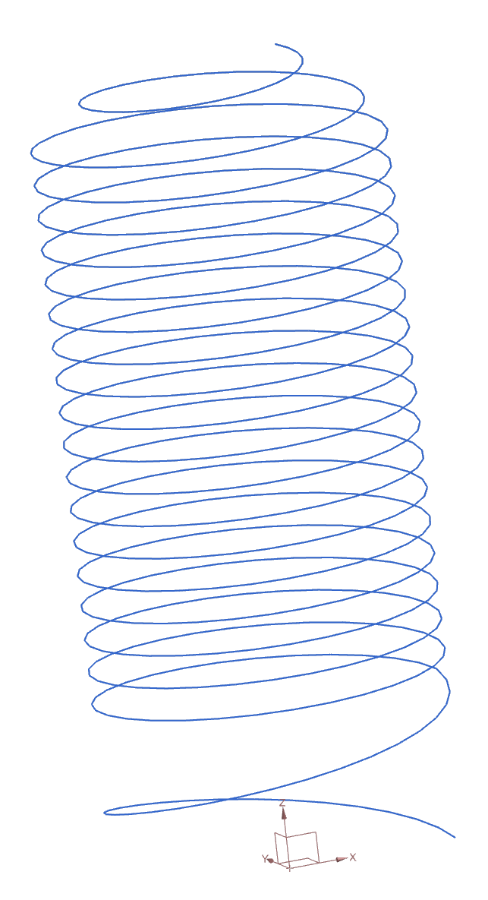
Advance Curves
Helix (Spiral): a line that cannot be represented in a single plane
Splines
Law Curves
Notes:
Josh
Helix are type of law curve
splines is a curve that does not have constant radius
complex algorithm where the user can determine how accurate it can be
Law curves are parametric line where you can have curves according to x, y, z change over time of t
every curve can be represented as law curve
the complication of the equations that deal with law curves it is nice to be able draw a circle without the law curve equation
If NX does not support that feature then Law Curve equations are available to manipulate

Slide 12
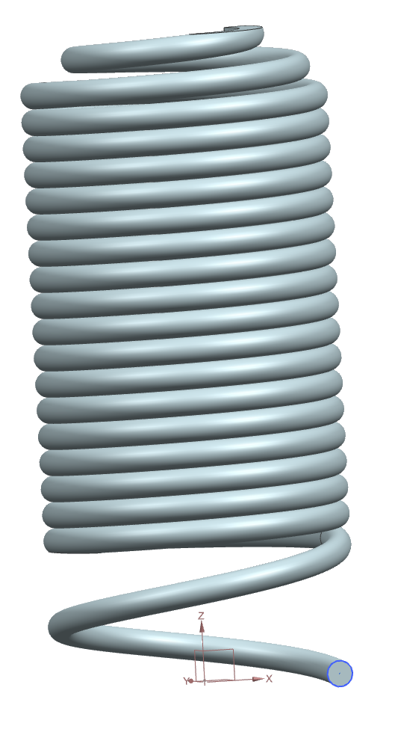
Advance 3D Modeling Features
Sweep
Sheets Manipulation
Notes:
Josh
With more advance curves, extrusion and revolution method might not be able to be applied to the figure you want
There are many sweeps methods
Sweeps is using a line as a guide and a shape where the shape will sweeps across the line.
The shape follows the line as a guide to get the final 3D shape you wanted
As you can see we have a spring in the picture
This was made with the sweep method where at the bottom there is a small circle and will travel up the line to create the spring.
Sheets manipulation is when you use a line to sweep over another line. This creates a 3 dimensional plane of with a line that has a thickness of 0
This method comes in handy when needing to model a figure that is directly supported.

Slide 13
Constraints
Geometric Constraints
-Geometric rules for objects
Dimensional Constraints
-Numerical rules for objects
Notes:
He
Geometric constraints
dimensional constraints

Slide 14
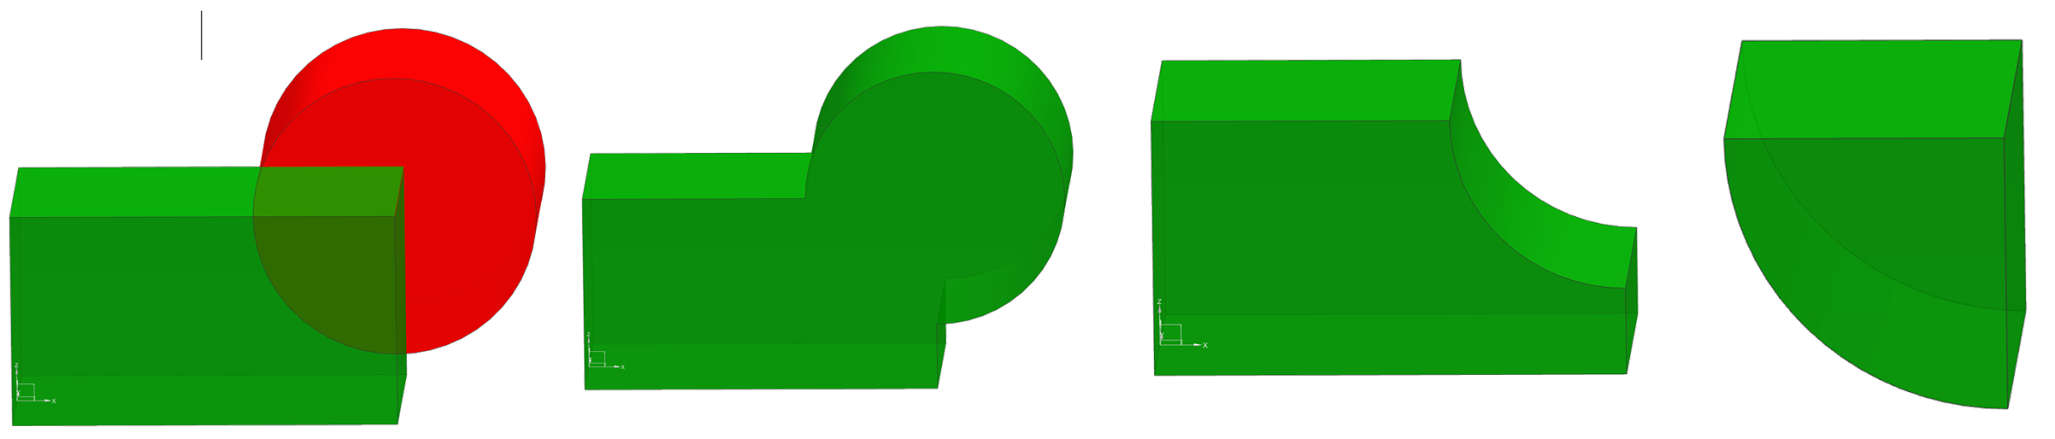
Solid Manipulation
Booleans
  None Unite Subtract Intersect
Notes:
Michael
Once you have a complete 3D shape, it can be joined with other 3D solids through the use of a variety of boolean operations. Some examples are union, subtract, intersect, and NX also features an “automatic” mode where it guesses what parts should be subtracted or joined based on how you have built the structure. An easy way to think about these is to think about boolean operations in logic. Union is equivalent to OR, where the output solid area is composed of input A OR B. Boolean subtract subtracts input A from B or vice versa. Intersect is equivalent to AND, where the output occupies the space taken up by both input A AND B.
Another useful operation is Trim which combines a boolean with a delete to split an object and delete the unwanted parts automatically.
When symmetry is present, shapes can be mirrored across a line to save time modeling the other side. If multiple copies are required, the pattern features function can be called to replicate a solid many times, akin to tiling a desktop background on windows.
Once the part is created from multiple solids, finishing operations such as Edge Blend and Chamfers can be applied. Edge Blend creates a fillet, or rounded edge from a sharp intersection of two surfaces. A chamfer is similar, but instead of a rounded edge, it is a hard 45 degree angle. These can be used to make parts assemble or move easier since they are more smooth, and also drastically increases the asthetics of your model.
Together all these 3D manipulations can be used to manipulate solids to create your first part!

Slide 15
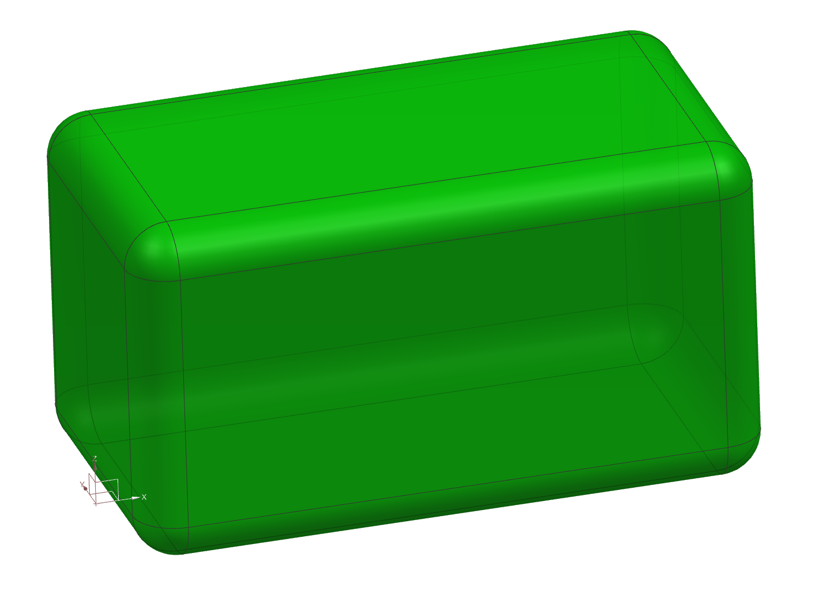
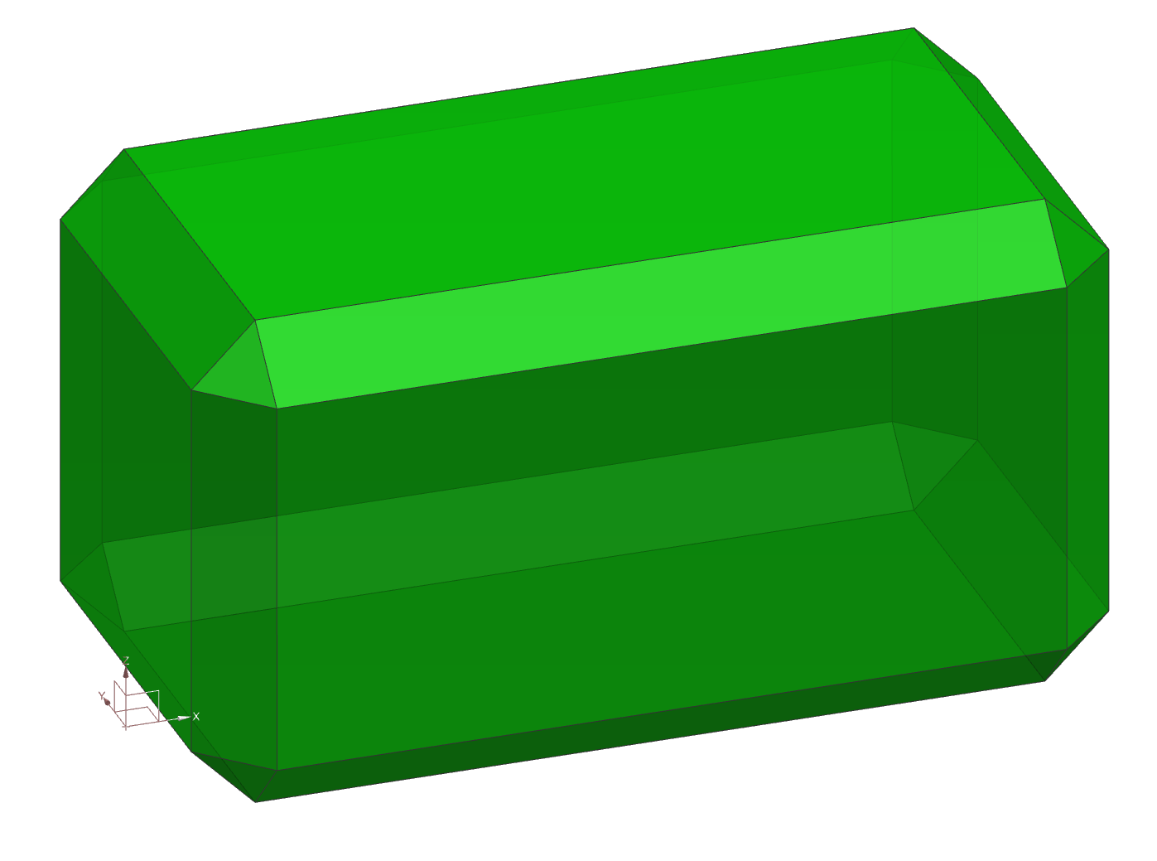
Solid Manipulation (Cont.)
Mirror
Pattern
Edge Blend
Chamfer
Many others
Notes:
Michael
Once you have a complete 3D shape, it can be joined with other 3D solids through the use of a variety of boolean operations. Some examples are union, subtract, intersect, and NX also features an “automatic” mode where it guesses what parts should be subtracted or joined based on how you have built the structure. An easy way to think about these is to think about boolean operations in logic. Union is equivalent to OR, where the output solid area is composed of input A OR B. Boolean subtract subtracts input A from B or vice versa. Intersect is equivalent to AND, where the output occupies the space taken up by both input A AND B.
/*
//Another useful operation is Trim which combines a boolean with a delete to split an object and delete the unwanted parts automatically.
*/
When symmetry is present, shapes can be mirrored across a line to save time modeling the other side. If multiple copies are required, the pattern features function can be called to replicate a solid many times, akin to tiling a desktop background on windows.
Once the part is created from multiple solids, finishing operations such as Edge Blend and Chamfers can be applied. Edge Blend creates a fillet, or rounded edge from a sharp intersection of two surfaces. A chamfer is similar, but instead of a rounded edge, it is a hard 45 degree angle. These can be used to make parts assemble or move easier since they are more smooth, and also drastically increases the asthetics of your model.
Together all these 3D manipulations can be used to modify solids to create your first part!

Slide 16
Assembly
- Made up of parts
- A part is the smallest separate structure in an assembly
- Each part can be modified easily to change the assembly
Notes:
He

Slide 17
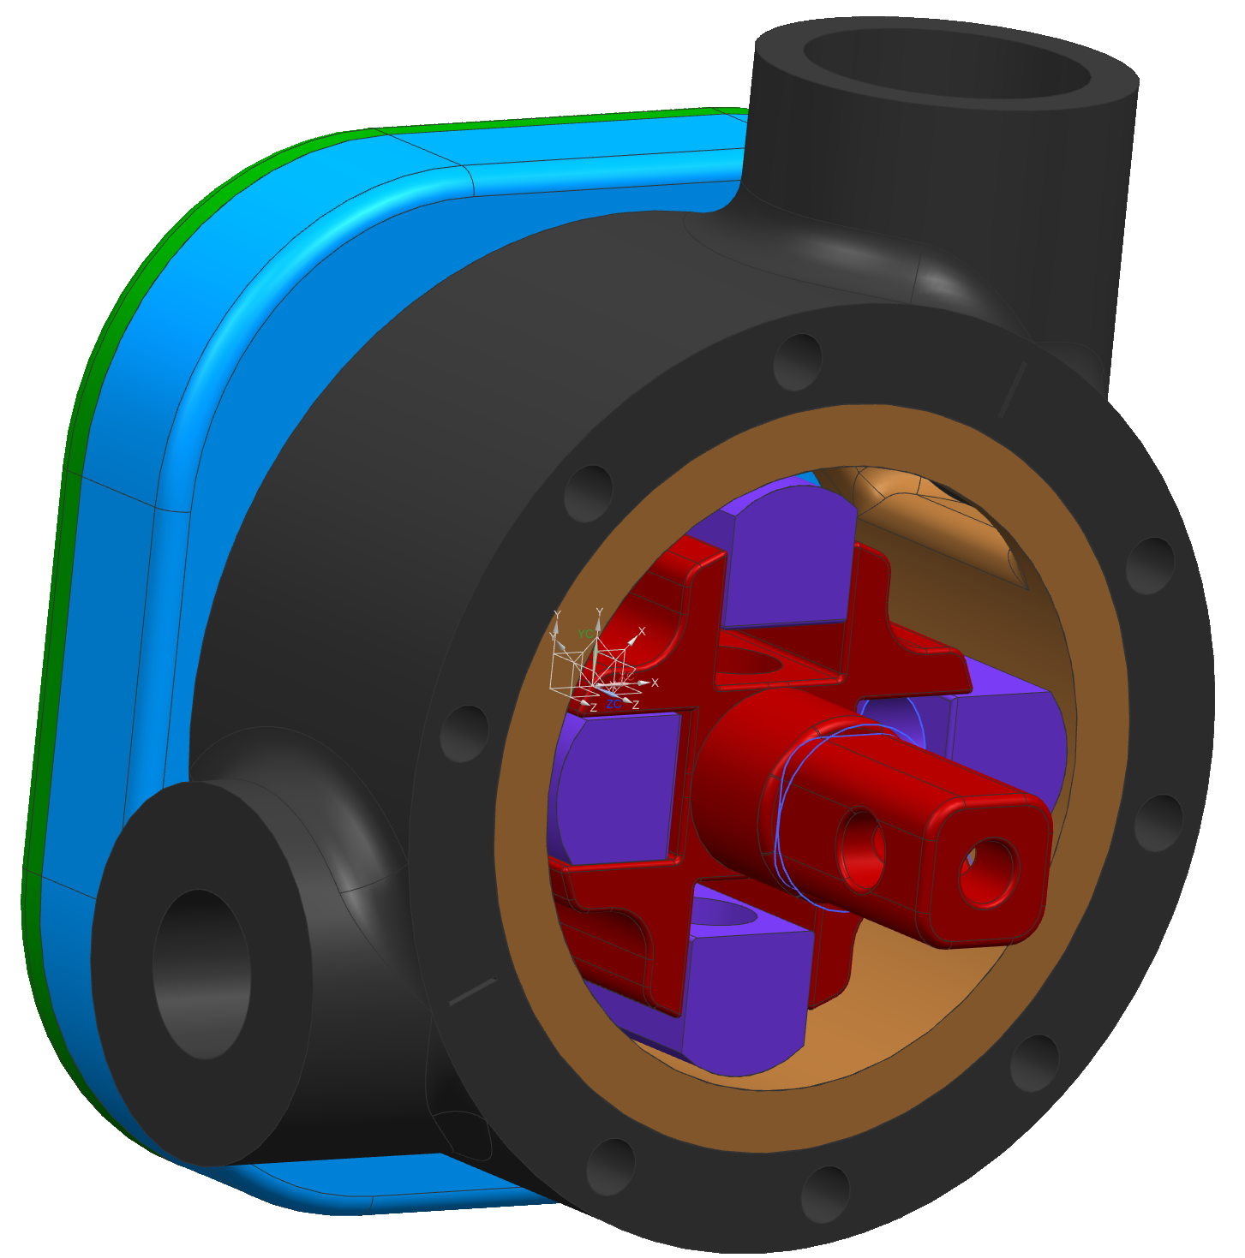
Assembly Constraint
Example: Rotary Vane Engine
Notes:
He

Slide 18
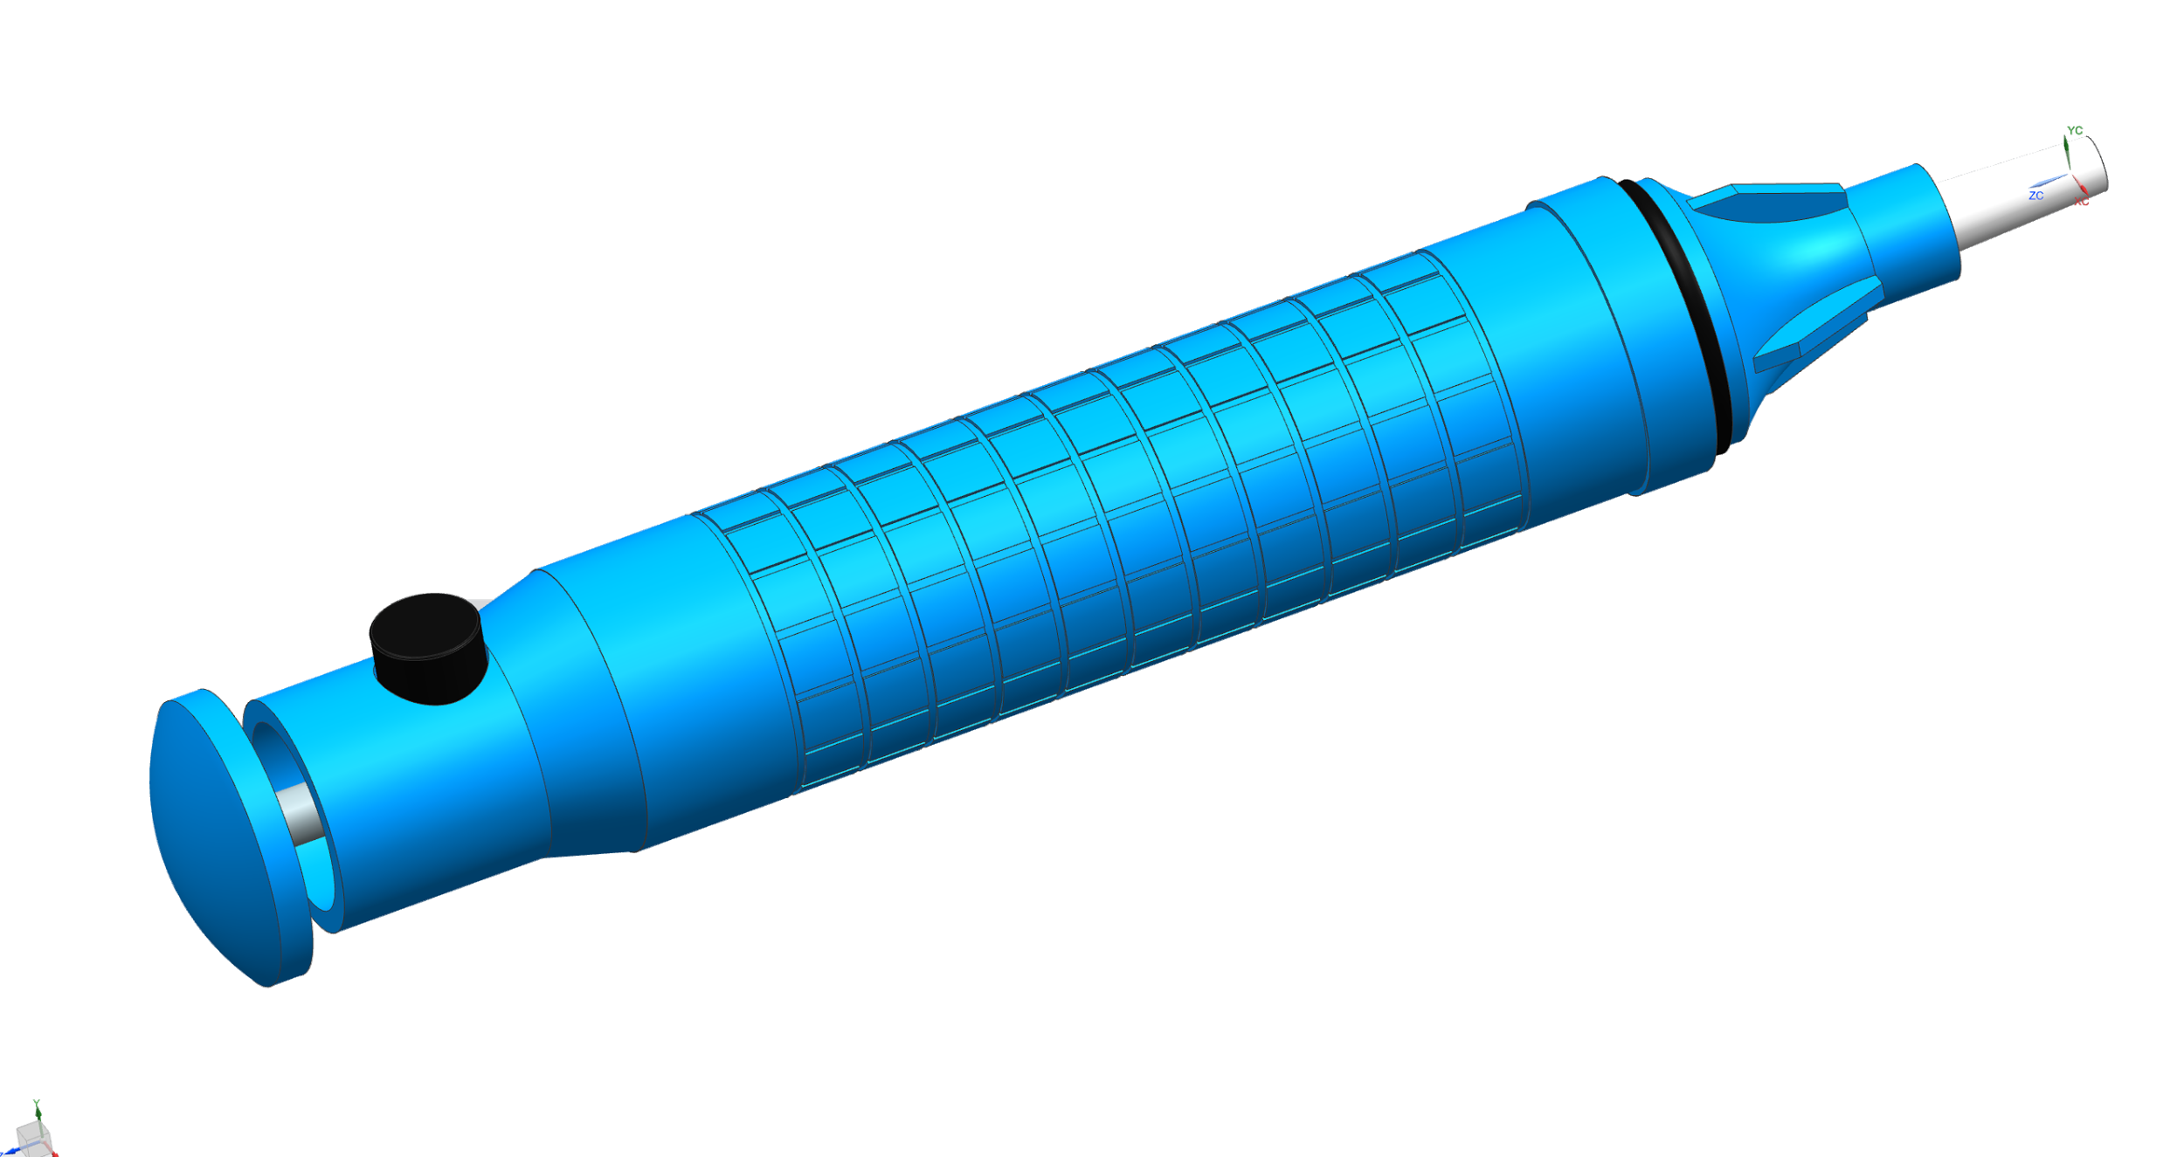
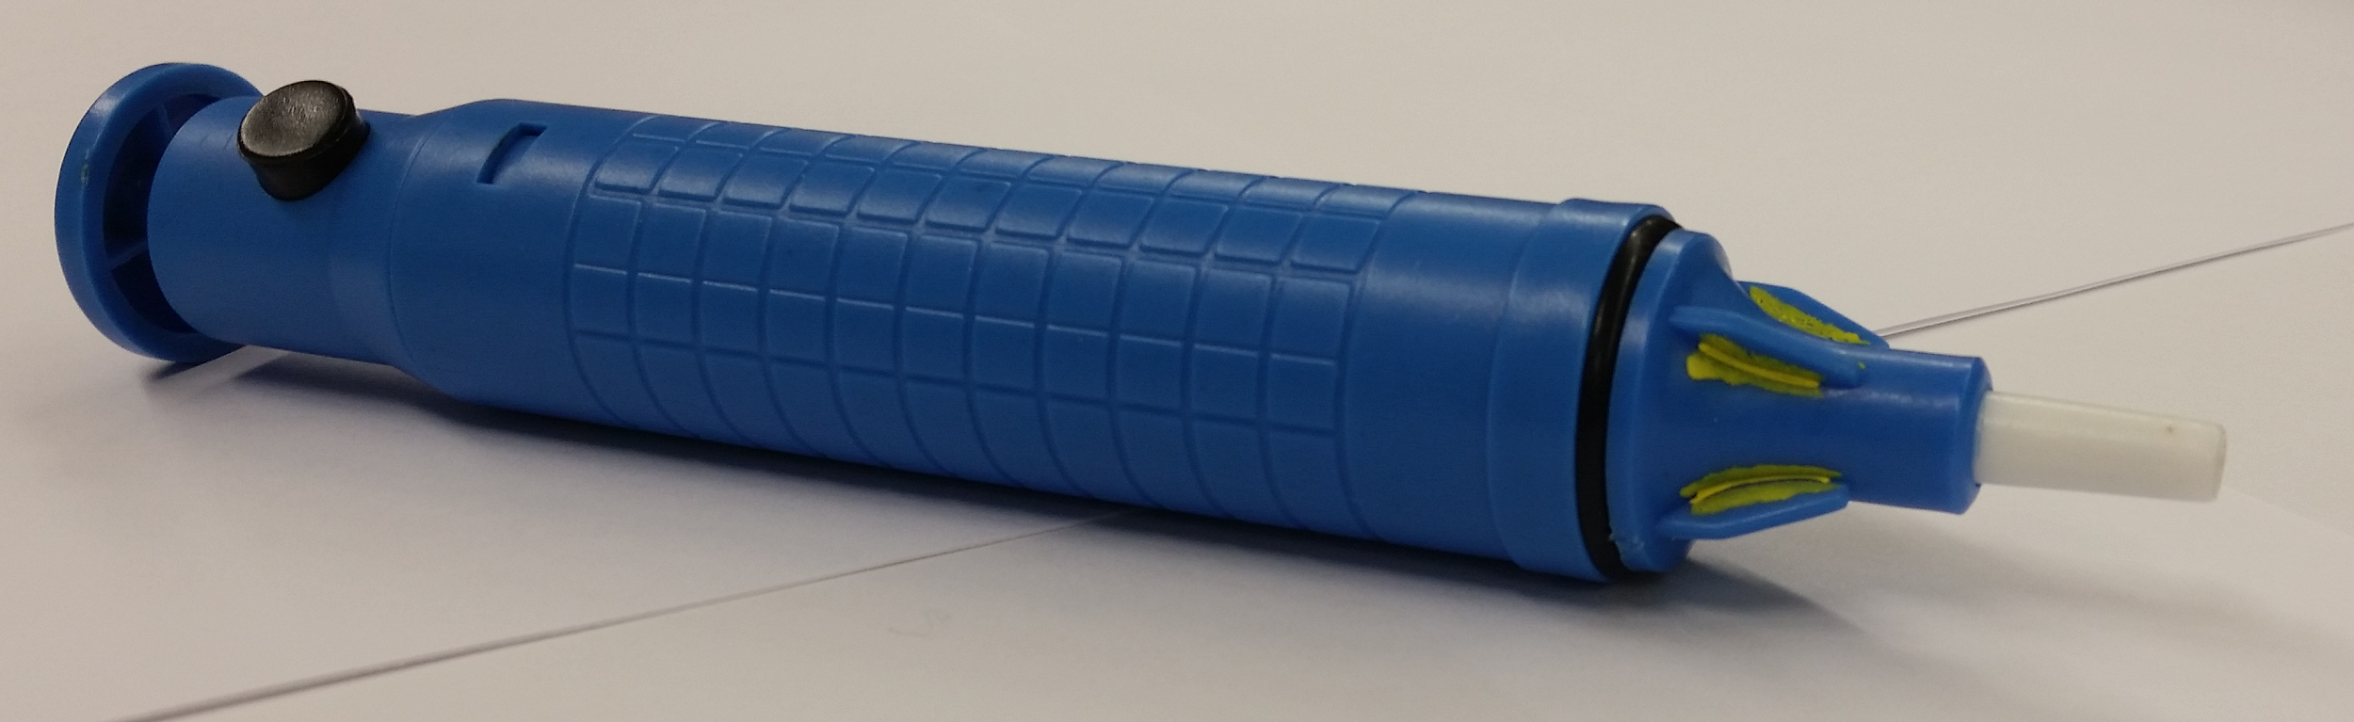
Examples: Solder Sucker
Example: Solder Sucker
Notes:
He

Slide 19
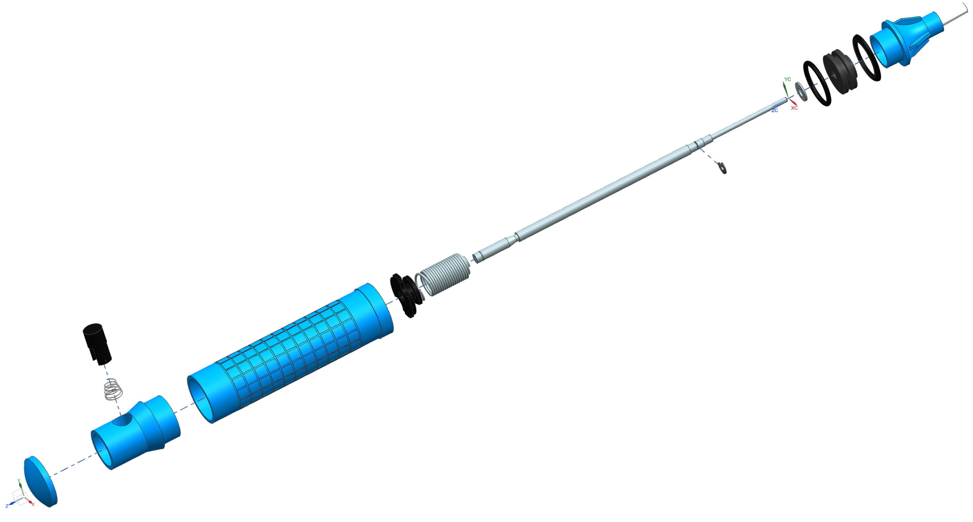
Examples: Solder Sucker
Cont.
Notes:
He

Slide 20
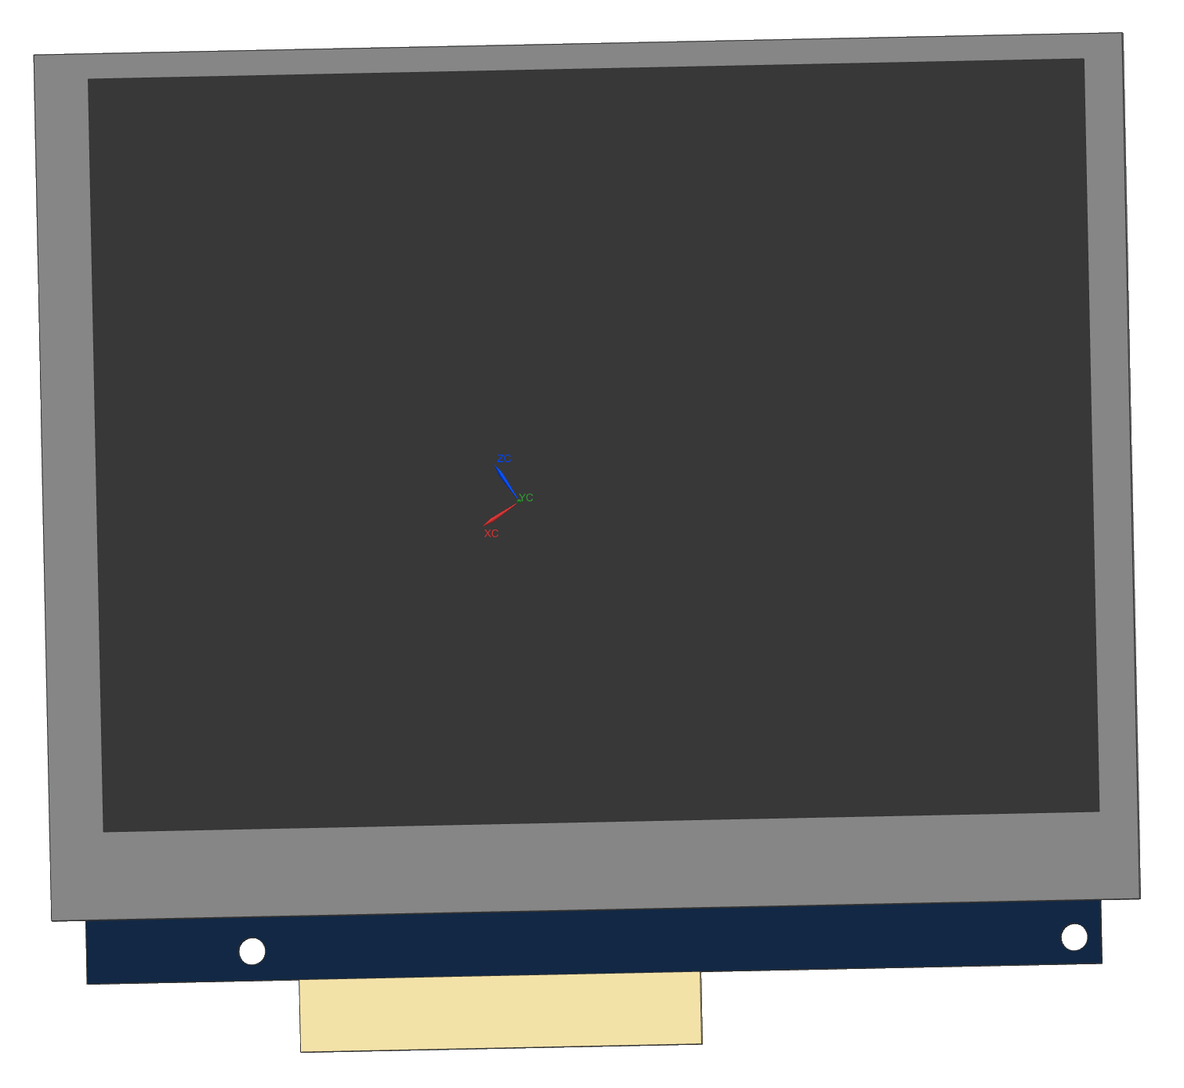
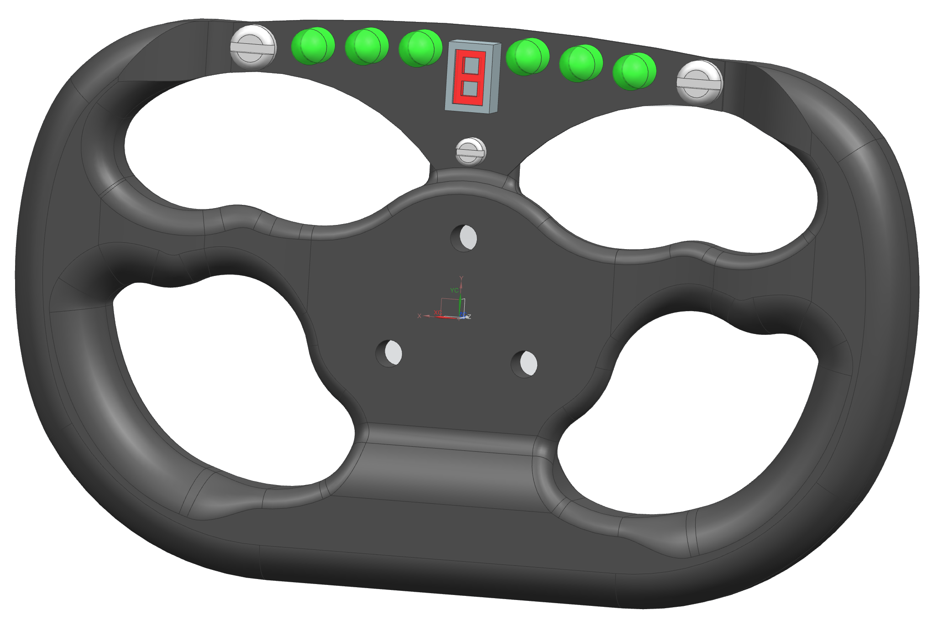
More Examples
Notes:
LCD Display: Modeled a LCD unit to be able to integrate it into other designs
Steering Wheel: A design of formula style steering wheel.

Slide 21
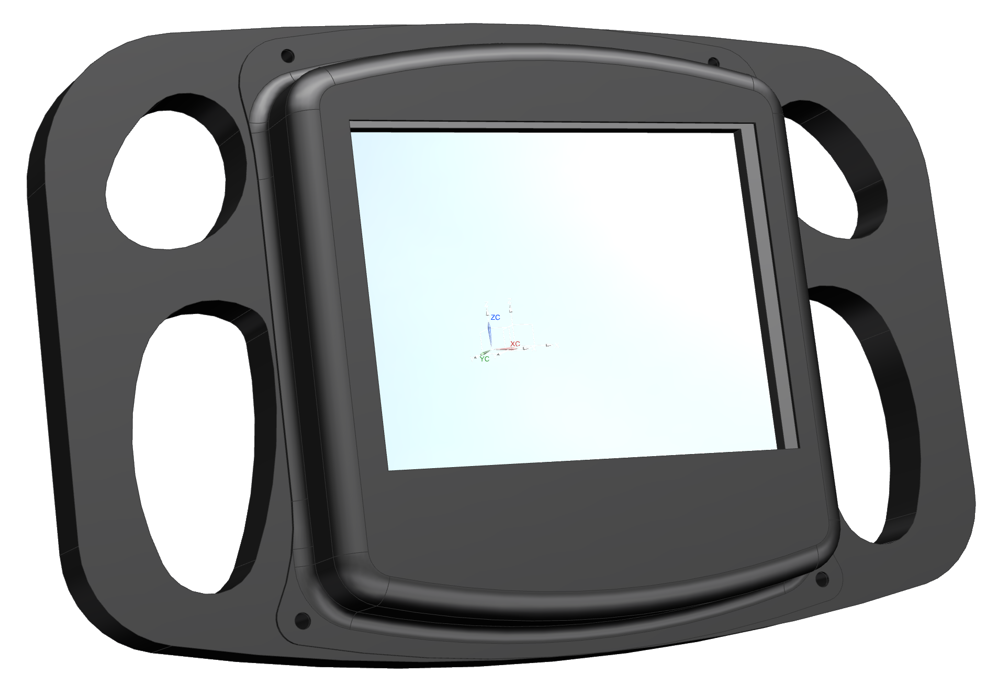
Last Example
Notes:
Use NX as a tool and not have it be the limiting factor to your design. This is a great example of using NX to design a part from different ideas.

Slide 22
Additional Information
http://nxtutorials.com/
https://grabcad.com/questions/tutorial-nx-shortcut-keys
Notes:
nxtutorials has a large collection of tutorials in video format, it is run by Siemens and Design Visionaries
the second link has a large collection of shortcut keys for various actions in NX

Slide 23
Sources
http://nxtutorials.com/
http://en.wikipedia.org/wiki/Siemens_NX

